Slide 1
第十九章 汽车行驶系统概述Chapter 19 Running Gear

Slide 2
主要内容
Main Contents
汽车行驶系统的功用、组成；The components and function of running gear;
驱动力引起的车轮中心反力矩对车轮前后载荷的影响；The influence of the counter-torque, which caused by the driving force, on the front and rear vertical wheel load;
汽车行驶系统的结构形式。The structure type of running gear

Slide 3
行驶系统的功用
The function of running gear
接受发动机传递的转矩，并通过驱动轮与地面的附着作用，产生驱动力并保证车辆的正常行驶；To receive the torque from the engine and produce driving force caused by the tire’s adhesion to the road surface, in order to ensure the normal driving conditions；
传递并承受路面作用于车轮的各种反力及其所形成的力矩；To transmit and receive forces and torques from the wheels；
减缓路面对车身的冲击，并衰减由此产生的振动，保证汽车的行驶平顺性；To mitigate impacts from the road surface，dampen the vibration and ensure the ride comfort of vehicles；
配合转向系统，实现车辆行驶方向的正确控制，并保证车辆的操纵稳定性；Co-operating with the steering system, to achieve the correct control of the direction of travel and ensure the handling stability of vehicles；
配合制动系统，保证车辆的制动性。Co-operating with the braking system, to ensure the braking behavior of vehicles

Slide 4
汽车行驶系统的组成
The components of running gear
车 架：全车装配的基体，将整车有机的连接为整体，并承受汽车的载荷。Frame：to provide a supporting body for assemblies, fasten all main parts and units of the vehicle and withstand the static and dynamic loads
车 桥：连接左右车轮，承受并传递由车轮传来的载荷。Axle：to connect the left and right wheels, receive and transmit forces and torques from the wheels
车 轮（或履带）：支承整车，连接车身与地面，缓冲路面冲击载荷，产生驱动力和制动力，汽车转弯时产生侧向抗力并回正车轮，提高车辆的通过性。Wheel（or track）：to support the vehicle, connect the vehicle body and road, mitigate impacts from the road surface, produce driving force, braking force, create the lateral force and aligning torque while steering and improve the passing ability of vehicle
悬 架：将汽车行驶过程中车轮产生的力和力矩，传递到车架，并通过弹性、阻尼元件、导向杆系衰减汽车的振动，提高车辆的操纵稳定性和平顺性。Suspension: to transmit the forces and torques from the wheels to frame, dampen the vibration via the springs, dampers and connecting link, improve the handling stability and ride comfort of vehicles

Slide 5
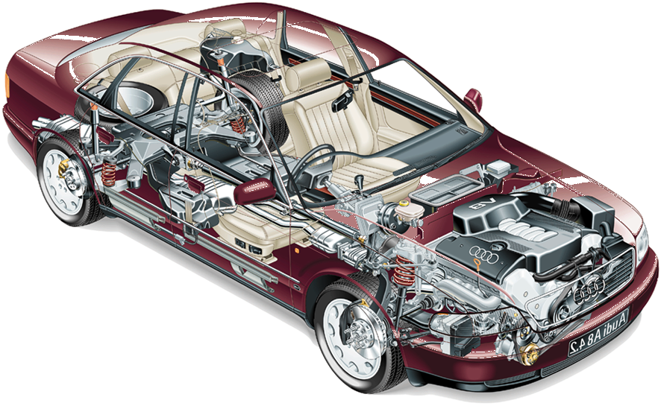
汽车行驶系统的组成
The components of running gear
行驶系统 Running gear

Slide 6
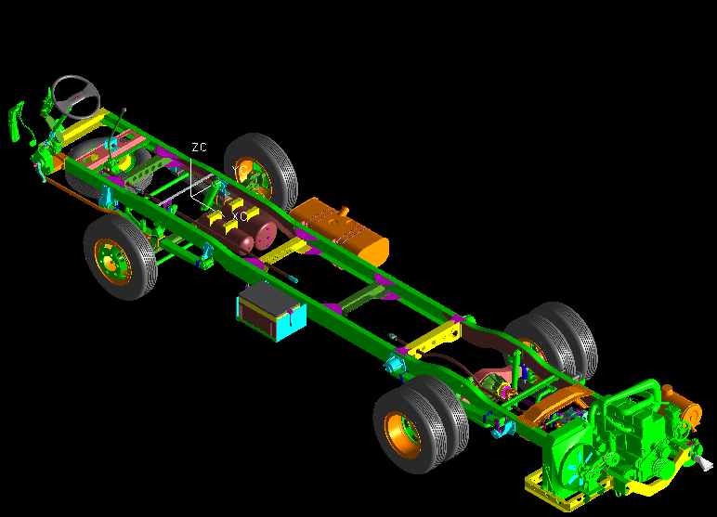
汽车行驶系统的组成
The components of running gear
行驶系统 running gear

Slide 7
汽车行驶系统的结构形式
The structure type of running gear
轮式行驶系统 wheeled running gear
半履带式行驶系统 half-tracked running gear
全履带式行驶系统 tracked running gear
车轮--履带式行驶系统 wheel—tracked running gear

Slide 8
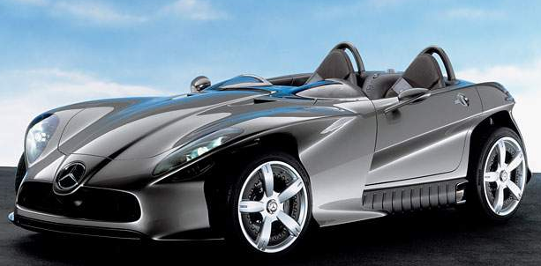
轮式汽车
Wheeled vehicles

Slide 9
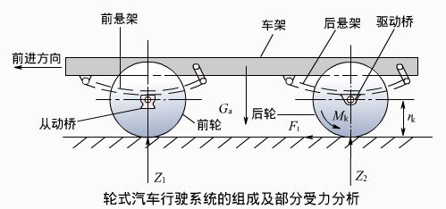
轮式行驶系统的动力传递 The power transmission of wheeled running gear
汽车的总重力 The gravity of the vehicle ：G_{a}
前后车轮的垂直反力 The supporting force at the front and rear wheel ：Z₁、Z₂
G_{a}=Z₁+Z₂
汽车的驱动转矩 The driving torque ：M_{k}
汽车的驱动力 The driving force ：F_{t}

Slide 10
轮式行驶系统的动力传递
The power transmission of wheeled running gear
F_{t}=F_{r}+F_{l}+F_{s}+F_{a}
滚动阻力 Rolling resistance F_{r}
坡道阻力 Climbing resistance F_{s}
空气阻力 Air resistance F_{l}
加速阻力 Inertial resistance F_{a}

Slide 11
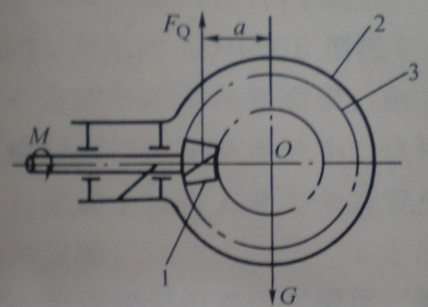
驱动力对前后车轮垂直载荷的影响
The influence of the driving force on the front and rear vertical wheel load
驱动力有使汽车前部向上抬起的趋势，后轮上的垂直载荷增大，前轮上的垂直载荷减小。As a result of the distance from the center of the wheels to the road ,the driving force causes a pitching torque, which increases the vertical load at the rear wheel and reduce the vertical load at the front wheel
制动力有使汽车前部向下俯倾的趋势，后轮上的垂直载荷减小，前轮上的垂直载荷增大。The driving force also causes a pitching torque, which increases the vertical load at the front wheel and reduce the vertical load at the rear wheel

Slide 12
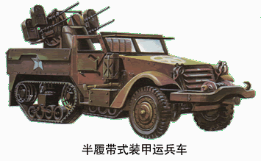
半履带式汽车 Half-tracked vehicles
半履带是指汽车的后桥采用履带式，前桥用车轮。On half-tracked vehicles, the tracks are mounted in the rear axle and the wheels are mounted in the front axle.
履带可以减少汽车对地面的比压，控制汽车下陷，履刺还能加强履带与土壤间的相互作用，增加汽车的附着力，提高通过性，主要用于在雪地或沼泽地带行驶的汽车。
The tracks can reduce the ground pressure and avoid the sinking of vehicles .The arista can increase the track’s adhesion to the soil and improve the passing ability of vehicles. The tracks are mainly used on the vehicles, which often run on the snow or marsh.

Slide 13
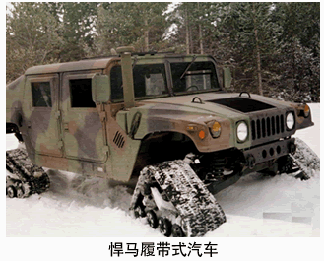
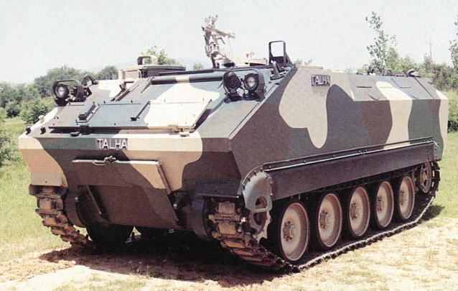
全履带式汽车 Tracked vehicles
前后桥都用履带称为全履带式。On tracked vehicles, the tracks are mounted on both front and rear axles.

Slide 14
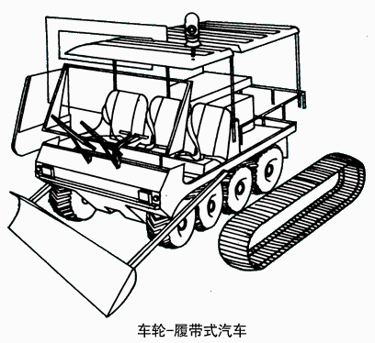
车轮—履带式汽车 Wheel—tracked vehicles
前后桥即可装车轮，也可装履带，称为车轮履带式。 On wheel—tracked vehicles, the front and rear axles can be equipped with wheels or tracks.

Slide 15
本章学习重点
Main points of Chapter 19
汽车行驶系统的功用；
The function of running gear；
驱动力对车轮中心造成的反力矩对车轮前后载荷的影响。
The influence of the counter-torque, which caused by the driving force, on the front and rear vertical wheel load.

Slide 16
作业Homework
汽车行驶系统的功用是什么？它主要由那些部件和总成组成？各起什么作用？What is the function of running gear? What is the running gear consist of？What are the functions of these components?
试分析整体式车桥和断开式车桥中主减速器壳上由地面驱动力F_{t}对车轮中心造成的反力矩是如何传到车架上的? On vehicles with dependent or independent suspension, try to analyze how the counter-torque caused by the driving force transmits from the final drive housing to the frame

